Slide 1

Dominating the lies in the iip - domi Sub-Scale nida cocaine data analysis for improved weighting and predictions of iip – domi sub scale
Natalie LePera
STA513
Final Project
Due: 09 Dec 2025

Slide 2
Understanding the
IIP – DOMI Sub-Scale
IIP – DOMI Sub-Scale Questions
It is hard for me to understand another person’s point of view.
I argue with other people too much.
I try to control other people too much.
I am too aggressive toward other people.
Inventory of Interpersonal Problems
  32 questions, 8 sub-scales 4 questions per scale
  Self reported
  Potentially high patient burden when paired with other assessments
  Potential for missed responses when used without eCOA
    eCOA can be cost prohibitive
Current imputation processes¹
  Mean score replacement for single value imputation, omitted if multiple values require imputation
Self reporting requires self awareness and honest assessment of close relationships
  Honest assessment may be impacted by underlying psychological comorbidities, antisocial behaviors, or other unknown factors
Score | Response
0 | Not at all
1 | A little bit
2 | Moderately
3 | Quite a bit
4 | Extremely
  [1] https://jmgirard.com/wp-content/uploads/2018/02/IIP-C-IRTv1.0.pdf

Slide 3
Model Aims
Model 1:
  Analyze the potential relationship between DOMI score and treatment type with best fit covariates to determine if treatment type impacts patients’ self reported DOMI scores
  H0: Mean DOMI score is equal across all 4 treatment groups
Model II:
  Analyze the potential relationship between DOMI score and the interaction of treatment type and type of cocaine used (cocaine or crack) to determine if the combination of treatment type and type of cocaine used impacts patients’ self reported DOMI scores
  H0: Mean DOMI score is equal across all 8 combinations of treatment type and type of cocaine used
Model III
  Analyze the potential relationship between DOMI score and a selection of aggregate “home stability” variables, comprised of the interaction between marital status (married or single), employment status, and education status (HS diploma, GED, or lesser education vs greater than HS education) to determine if the combination of home stability variables impacts patients’ self reported DOMI scores
  H0: Mean DOMI score is equal across all 8 combinations of marital status, employment status, and education status

Slide 4
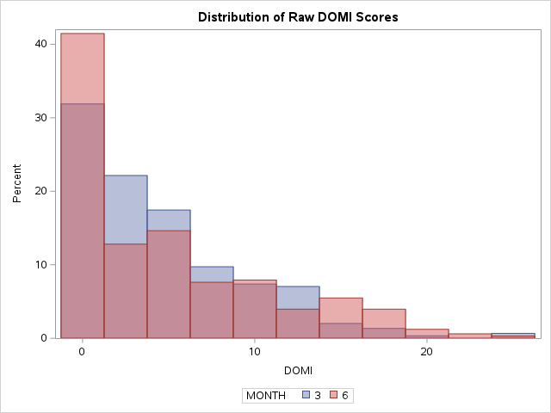
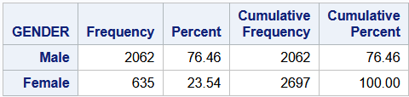
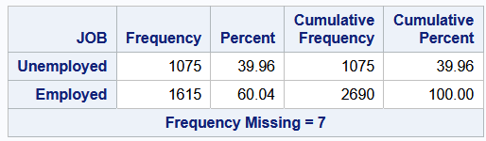
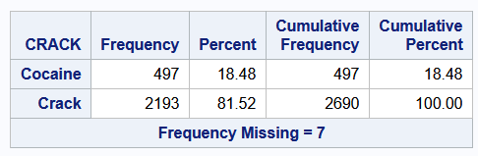

Domi details: NIDA COCAINE STUDY
Full data: 2697 observations
Missing observations:
  3 months = 52 missing (14.86%)
  6 months = 50 missing (13.23%)
DOMI scores skewed and potential poisson distribution
  Requires shift
  Requires BoxCox transformation
    $$\hat{Y}\left\{\begin{aligned}\frac{x^{λ} −1}{λ} where λ≠0 \\ \ln\left(x\right) where λ=0\end{aligned}\right.$$
Outputs must be back transformed before utilization

Slide 5
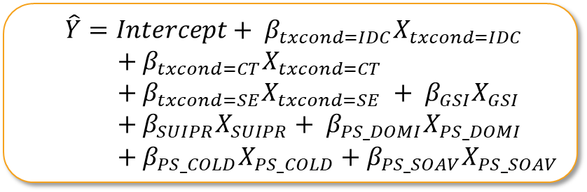
Model 1 Creation
Prior to adding covariate, passed HOV (p = 0.0849 > 0.05)
The main effect of treatment on DOMI score was analyzed with several covariates
Model developed using stepwise deletion
Treatment determined to be non-significant regardless of model construction
  Treatment selected a priori and thus retained in reduced model
Data transformations
  Shift: DOMI + 0.1
  BoxCox Transform: best λ = 0.25
  SW Normality after shift/transform: p = 0.0409
Measure/Scale Name | Variable
Treatment Condition 1 = IDC / 2 = CT / 3 = SE / 4 = GDC | TX_COND
Beck Global Severity Index | GSI
Self Understanding Interpersonal Problems – Recognition | SUIPR
Baseline Inventory of Interpersonal Problems – Dominance Subscale | PS_DOMI
Baseline Inventory of Interpersonal Problems – Cold Subscale | PS_COLD
Baseline Inventory of Interpersonal Problems – Socially Avoidant Subscale | PS_SOAV
NOTE: Residuals of model I for DOMI were unable to be normalized despite shifting and completing a box-cox transformation; any interpretations from this model should be considered with caution due to this violation of normality assumption

Slide 6
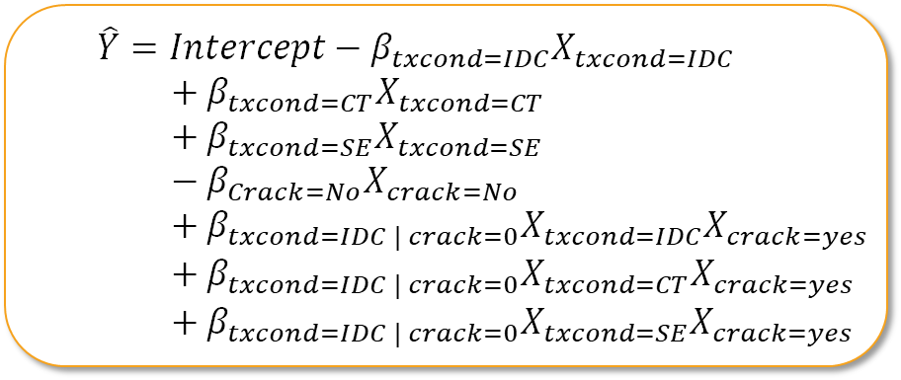
Model 2 Creation
$\hat{Y}=Intercept−β_{txcond=IDC}X_{txcond=IDC}$
$+ β_{txcond=CT}X_{txcond=CT}$
$+ β_{txcond=SE}X_{txcond=SE}$
$− β_{Crack=No}X_{crack=No}$
$+ β_{txcond=IDC | crack=0}X_{txcond=IDC}X_{crack=yes}$
$+ β_{txcond=IDC | crack=0}X_{txcond=CT}X_{crack=yes}$
$+ β_{txcond=IDC | crack=0}X_{txcond=SE}X_{crack=yes}$
The relationship between the interaction of treatment condition and type of cocaine used and patients’ DOMI scores was analyzed
Model developed from a priori hypothesis rather than data fit driven approach
Data transformations
  Shift: DOMI + 0.1
  BoxCox Transform: best λ = 0.25
  SW Normality after shift/transform: p < 0.010
Measure/Scale Name | Variable
Treatment Condition 1 = IDC / 2 = CT / 3 = SE / 4 = GDC | TX_COND
Cocaine Use Type 0 = standard cocaine / 1 = crack | CRACK
NOTE: Residuals of model II for DOMI were unable to be normalized despite shifting and completing a box-cox transformation; any interpretations from this model should be considered with caution due to this violation of normality assumption
Notes:
While no significant main effects and no significant interaction (overall) found during model creation, significant relationship found for all levels of treatment except IDC in full data

Slide 7
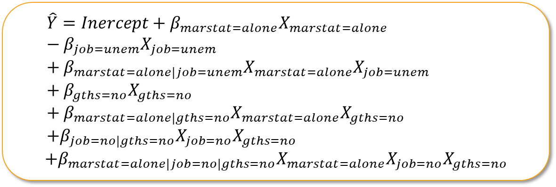
Model 3 Creation
The relationship between of “home stability” variables and DOMI score was analyzed
Model developed from a priori hypothesis rather than through a data driven approach
Data transformations
  Shift: DOMI + 0.1
  BoxCox Transform: best λ = 0.25
  SW Normality after shift/transform: p < 0.0001
Measure/Scale Name | Variable
Marital Status 1 = Married or Cohabitating / 2 = Lives Alone | MAR_STAT
Job 1 = Employed / 0 = Unemployed | JOB
Greater Than High School Education 1 = Greater than HS education / 0 = HS Diploma, GED, or Lesser Education | GTHS
NOTE: Residuals of model III for DOMI were unable to be normalized despite shifting and completing a box-cox transformation; any interpretations from this model should be considered with caution due to this violation of normality assumption
Notes:
While only the marital status main effect proved significant across the whole dataset, all possible 3-way interactions except for the combination of unmarried, employed, and HS education were significant during model creation

Slide 8
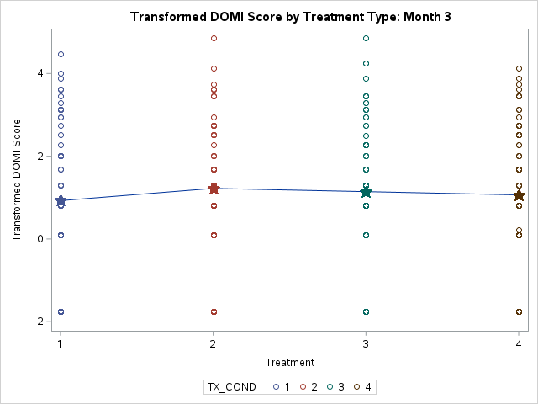
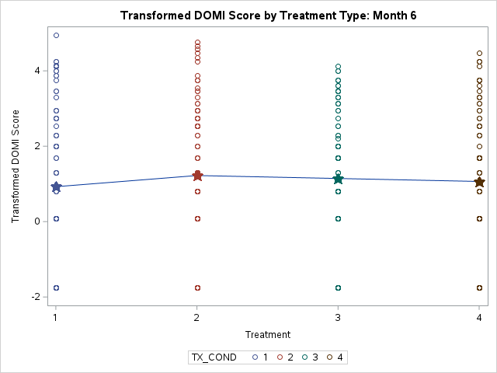
Model I Analysis (OVERALL)
Model explains approx. 65.0% of variance in DOMI scores
(R² = 0.422459)
No significant difference in average DOMI scores across the 4 treatment groups at the 3-month cut
(p = 0.9166 > 0.05)
Baseline Socially Avoidant score (PS_SOAV) found to be only marginally significant as a covariate at the 3-month cut
(p = 0.0683 > 0.05)
Model explains approx. 69.1% of variance in DOMI scores
(R² = 0.477021)
No significant difference in average DOMI scores across the 4 treatment groups at the 6-month cut
(p = 0.5015 > 0.05)
Baseline Socially Avoidant score (PS_SOAV) found to be only marginally significant as a covariate at the 6-month cut
(p = 0.3305 > 0.05)

Slide 9
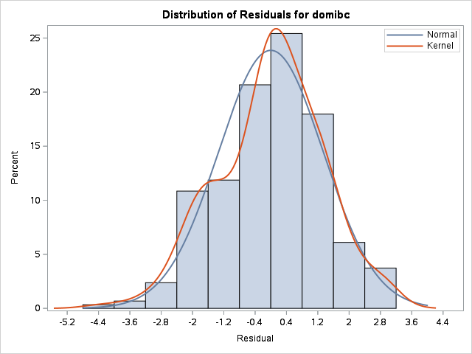
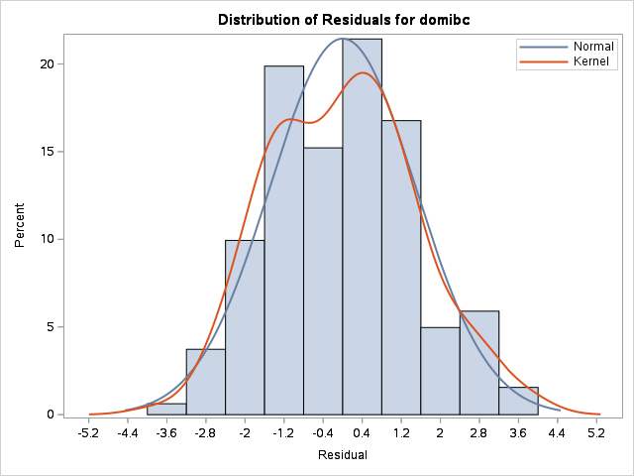
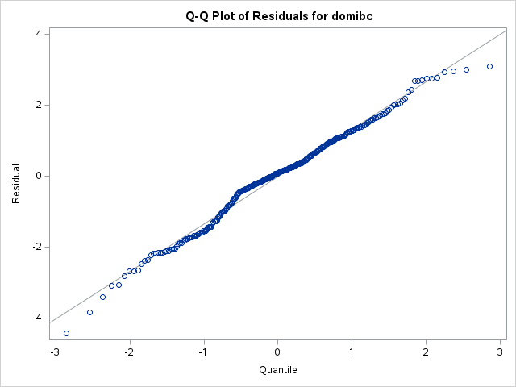
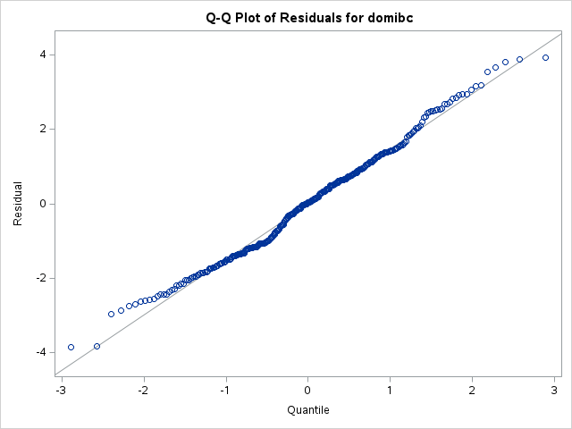
Model 1 Analysis (Residuals)
Month 3 Data Cut
Month 6 Data Cut
Residuals still fail Shapiro-Wilks
test of normality
(p = 0.0271 < 0.05)
Residuals still fail Shapiro-Wilks test of normality (p < 0.010 < 0.05)

Slide 10
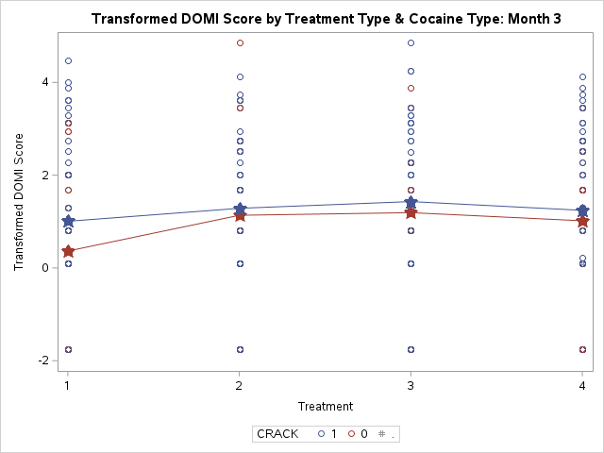
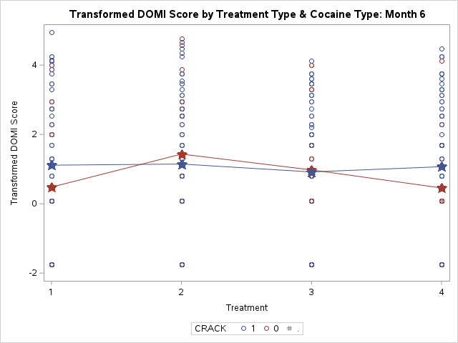
Model 1I Analysis (overall)
Model explains approx. 13.75% of variance in DOMI scores
(R² = 0.018918)
Interaction between treatment type and type of cocaine used observed as Ordinal at the 3-month cut
No significant overall interaction between treatment condition and cocaine type observed
(p = 0.9071 > 0.05)
No significant main effects of treatment type or cocaine type observed
(p_{tx} = 0.3262 > 0.05 & p_{crack} = 0.2146 > 0.05)
Model explains approx. 9.87% of variance in DOMI scores
(R² = 0.009746)
Interaction between treatment type and type of cocaine used observed as Disordinal at the 6-month cut
No significant overall interaction between treatment condition and cocaine type observed
(p = 0.6298 > 0.05)
No significant main effects of treatment type or cocaine type observed
(p_{tx} = 0.8518 > 0.05 & p_{crack} = 0.4334 > 0.05)

Slide 11
Model II Comparative Analysis
DOMI Scores back transformed to match true scale
(0 – 16)
Comparative Analysis Aims | Month 3 | Month 6
Comparison of average DOMI scores for crack users in the Psychotherapy (CT or SE) treatment groups to average DOMI scores for crack users in Drug Counseling (IDC or GDC) groups | PS group on average 1.564 more than DC group (crack) | PS group on average 1.967 more than DC group (crack)
Comparison of average DOMI scores for cocaine users in the Psychotherapy (CT or SE) treatment groups to average DOMI scores for cocaine users in Drug Counseling (IDC or GDC) groups | PS group on average 1.256 more than DC group (cocaine) | PS group on average 0.942 more than DC group (cocaine)
Comparison of the average difference in average DOMI scores between Psychotherapy and Drug Counseling for crack users to the average difference in average DOMI scores between Psychotherapy and Drug Counseling for cocaine users | Crack group on average 1.261 more than cocaine group | Crack group on average 2.067 more than cocaine group

Slide 12
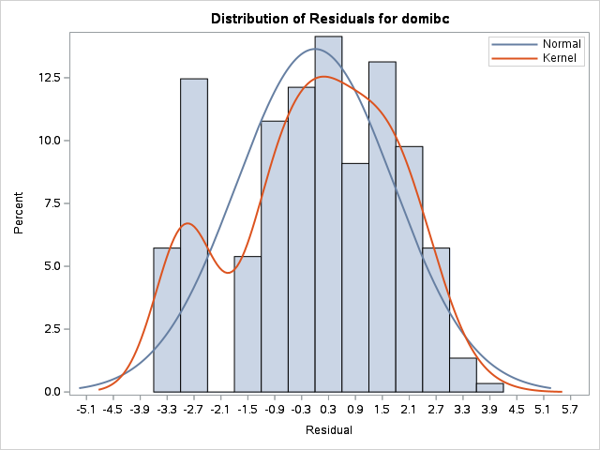
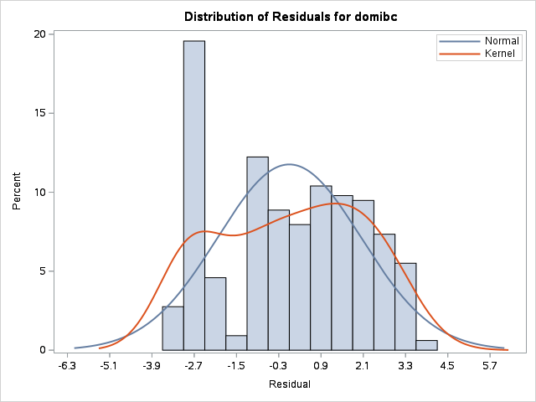
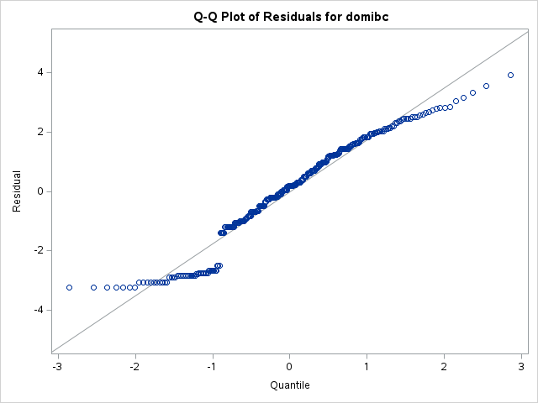
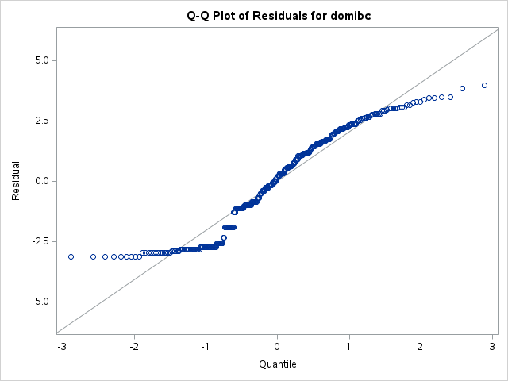
Model II Analysis (Residuals)
Month 3 Data Cut
Month 6 Data Cut
Residuals still fail Shapiro-Wilks
test of normality
(p < 0.0001 < 0.05)
Residuals still fail Shapiro-Wilks
test of normality
(p < 0.0001 < 0.05)

Slide 13
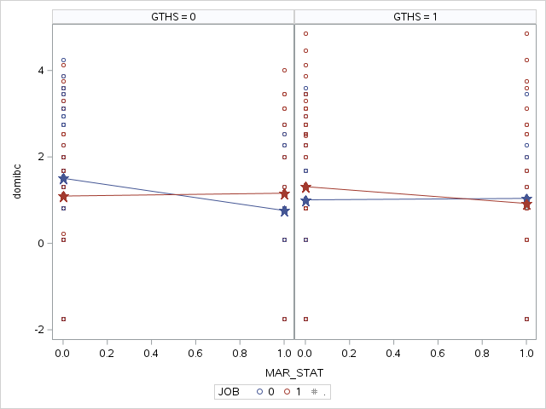
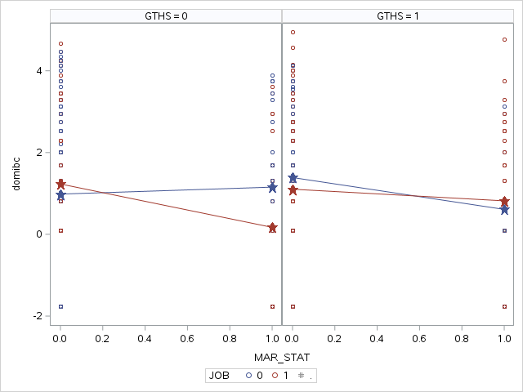
Model III Analysis (overall)
Model explains approx. 12.56% of variance in DOMI scores
(R² = 0.015768)
Interaction between marital status and employment status across both levels of education status observed as Disordinal at the 3-month cut
No significant overall interaction between marital status, employment status, and education status observed
(p = 0.21531 > 0.05)
No significant main effects of marital status, employment status, or education status observed
(p_{mar_stat} = 0.2983 > 0.05, p_{job} = 0.8579 > 0.05, & p_{education} = 0.8110 > 0.05)
Model explains approx. 15.20% of variance in DOMI scores
(R² = 0.023108)
Interaction between marital status and employment status across both levels of education status observed as Disordinal at the 6-month cut
No significant overall interaction between marital status, employment status, and education status observed
(p = 0.1305 > 0.05)
No significant main effects of marital status, employment status, and education status observed but main effect of marital status marginal
(p_{mar_stat} = 0.0680 > 0.05, p_{job} = 0.6352 > 0.05, & p_{education} = 0.4891 > 0.05)

Slide 14
Model III Comparative Analysis
DOMI Scores back transformed to match true scale
(0 – 16)
Comparative Analysis Aims | Month 3 | Month 6
Difference in DOMI scores for patients meeting full “household security” (married, employed, above HS education) and patients meeting no “household security” (lives alone, unemployed, HS education or less) | Full household security group on average 1.722 more than no household security group | Full household security group on average 1.176 more than no household security group
Average difference in average DOMI scores between married and unmarried patients, controlling for employment status and education status | Married group on average 1.285 more than unmarried group | Married group on average 1.585 more than unmarried group
Average difference in average DOMI scores between employed and unemployed patients, controlling for marital status and education status | Employed group on average 0.956 more than unemployed group | Employed group on average 1.219 more than unemployed group
Average difference in average DOMI scores between patients with more than a HS education and patients with a HS education or less, controlling for employment status and marital status | More than HS education group on average 1.061 more than HS education or less group | More than HS education group on average 0.908 more than HS education or less group

Slide 15
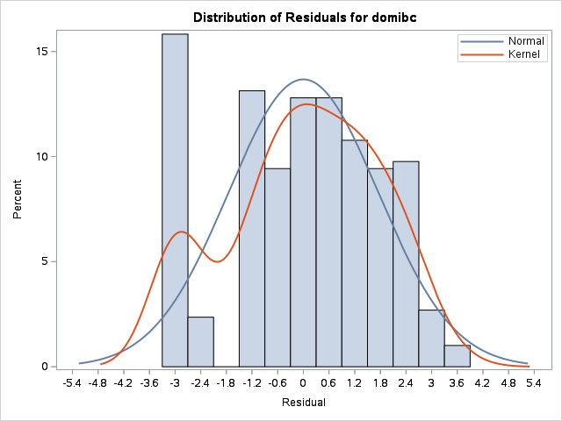

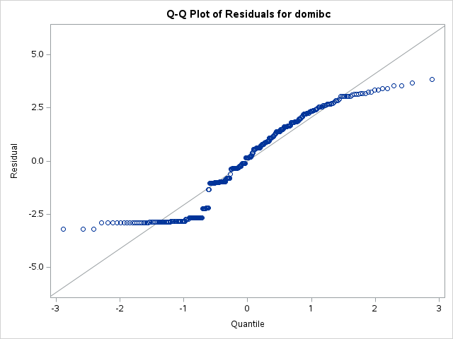
Model III Analysis (Residuals)
Month 3 Data Cut
Month 6 Data Cut
Residuals still fail Shapiro-Wilks
test of normality
(p < 0.0001 < 0.05)
Residuals still fail Shapiro-Wilks
test of normality
(p < 0.0001 < 0.05)

Slide 16
Conclusions
The current recommended imputation processes for IIP-DOMI values results in a significant amount of missing data over the course of a study, resulting in poor modeling capabilities
As the residuals would not normalize for any of the models, all comparative analyses should be interpreted with caution
Overall there were several potential relationships that may exist in the data, but certain conclusions cannot be drawn to the violation of assumption of normality of residuals
  Three way interaction of “household security” should be reexamined with additional, more complete data
Unexpected outcome of higher DOMI scores with higher household securty
Models should also be re-explored in a longitudinal fashion to see if additional trends and relationships were missed

Slide 17
References
IIP with grading instructions
  https://jmgirard.com/wp-content/uploads/2018/02/IIP-C-IRTv1.0.pdf

